Slide 1
History Heroes
Term 4, Week 1

Slide 2
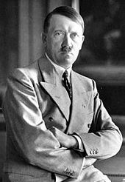
Who is this? (name, what were they know for? – 2 marks)

Slide 3
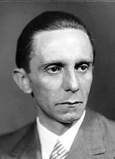
Who is this? (name, what were they know for? – 2 marks)

Slide 4
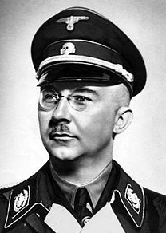
Who is this? (name, what were they know for? – 2 marks)

Slide 5
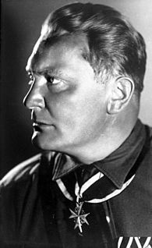
Who is this? (name, what were they know for? – 2 marks)

Slide 6
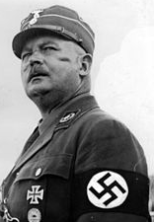
Who is this? (name, what were they know for? – 2 marks)

Slide 7
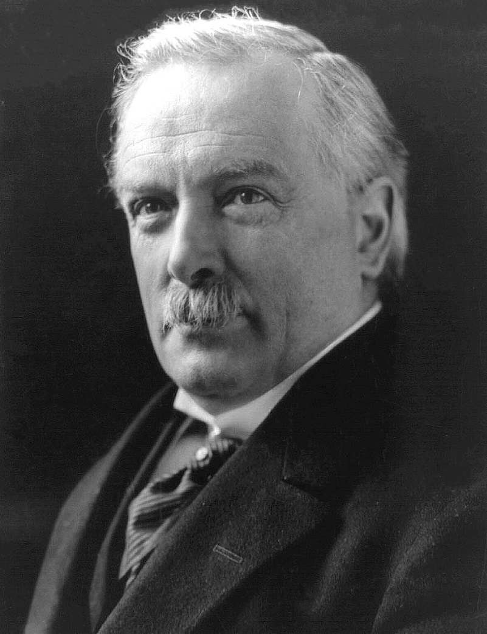
Who is this? (name, what were they know for? – 2 marks)

Slide 8
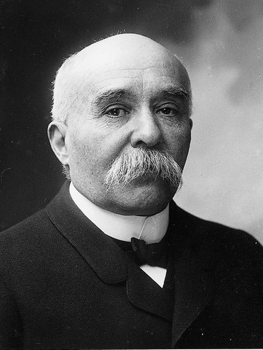
Who is this? (name, what were they know for? – 2 marks)

Slide 9
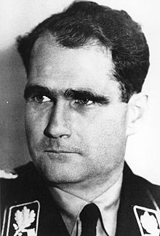
Who is this? (name, what were they know for? – 2 marks)

Slide 10
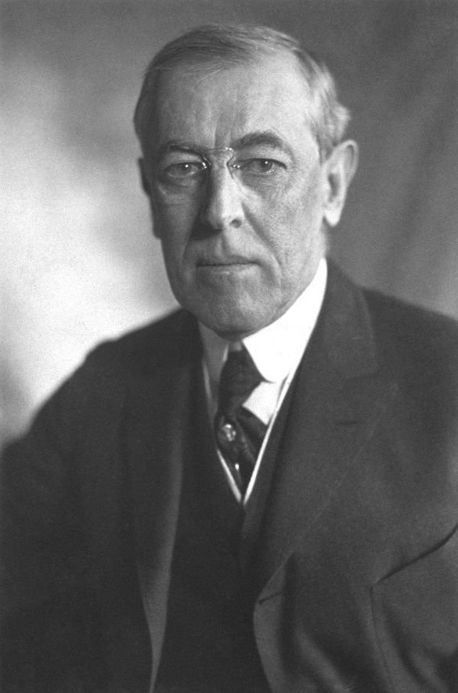
Who is this? (name, what were they know for? – 2 marks)

Slide 11
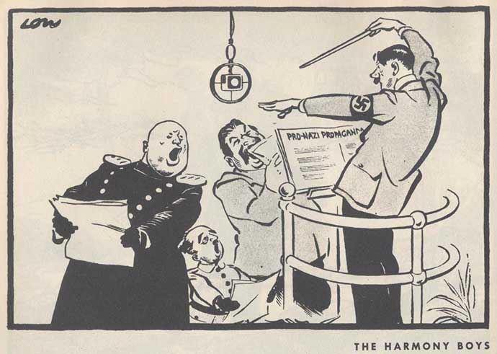
Who is depicted in this cartoon? (4 marks)

Slide 12
ANSWERS

Slide 13
Who is this? (name, what were they know for? – 2 marks)
Adolf Hitler
Leader of the Nazi Party

Slide 14
Who is this? (name, what were they know for? – 2 marks)
Joseph Goebbels
Minister for Propaganda and Public Enlightenment

Slide 15
Who is this? (name, what were they know for? – 2 marks)
Heinrich Himmler
Leader of the SS

Slide 16
Who is this? (name, what were they know for? – 2 marks)
Hermann Göring
Commander-in-Chief of the Luftwaffe (German Air Force), founder of the Gestapo in 1933, Minister of the Economic Four Year Plan

Slide 17
Who is this? (name, what were they know for? – 2 marks)
Ernst Röhm
Leader of SA
Died in 1934 on the Night of the Long Knives

Slide 18
Who is this? (name, what were they know for? – 2 marks)
David Lloyd George
Prime Minister of Great Britain, involved in deciding the terms of the Treaty of Versailles

Slide 19
Who is this? (name, what were they know for? – 2 marks)
Georges Clemenceau
Prime Minister of France during WW1, involved in deciding terms of Treaty of Versailles

Slide 20
Who is this? (name, what were they know for? – 2 marks)
Rudolf Hess
Deputy Führer to Adolf Hitler

Slide 21
Who is this? (name, what were they know for? – 2 marks)
Woodrow Wilson
President of USA during WW!, negotiated terms of Treaty of Versailles

Slide 22
Who is depicted in this cartoon? (4 marks)
Adolf Hitler
Benito Mussolini
Joseph Stalin
Francisco Franco

Slide 23
Results /22

Slide 24
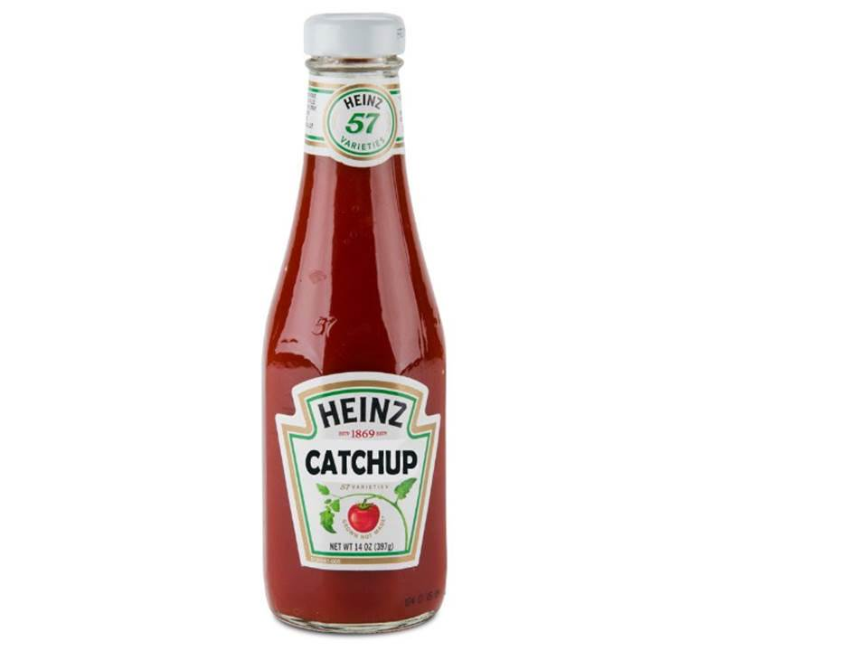
Source of the week

Slide 25
